Slide 1

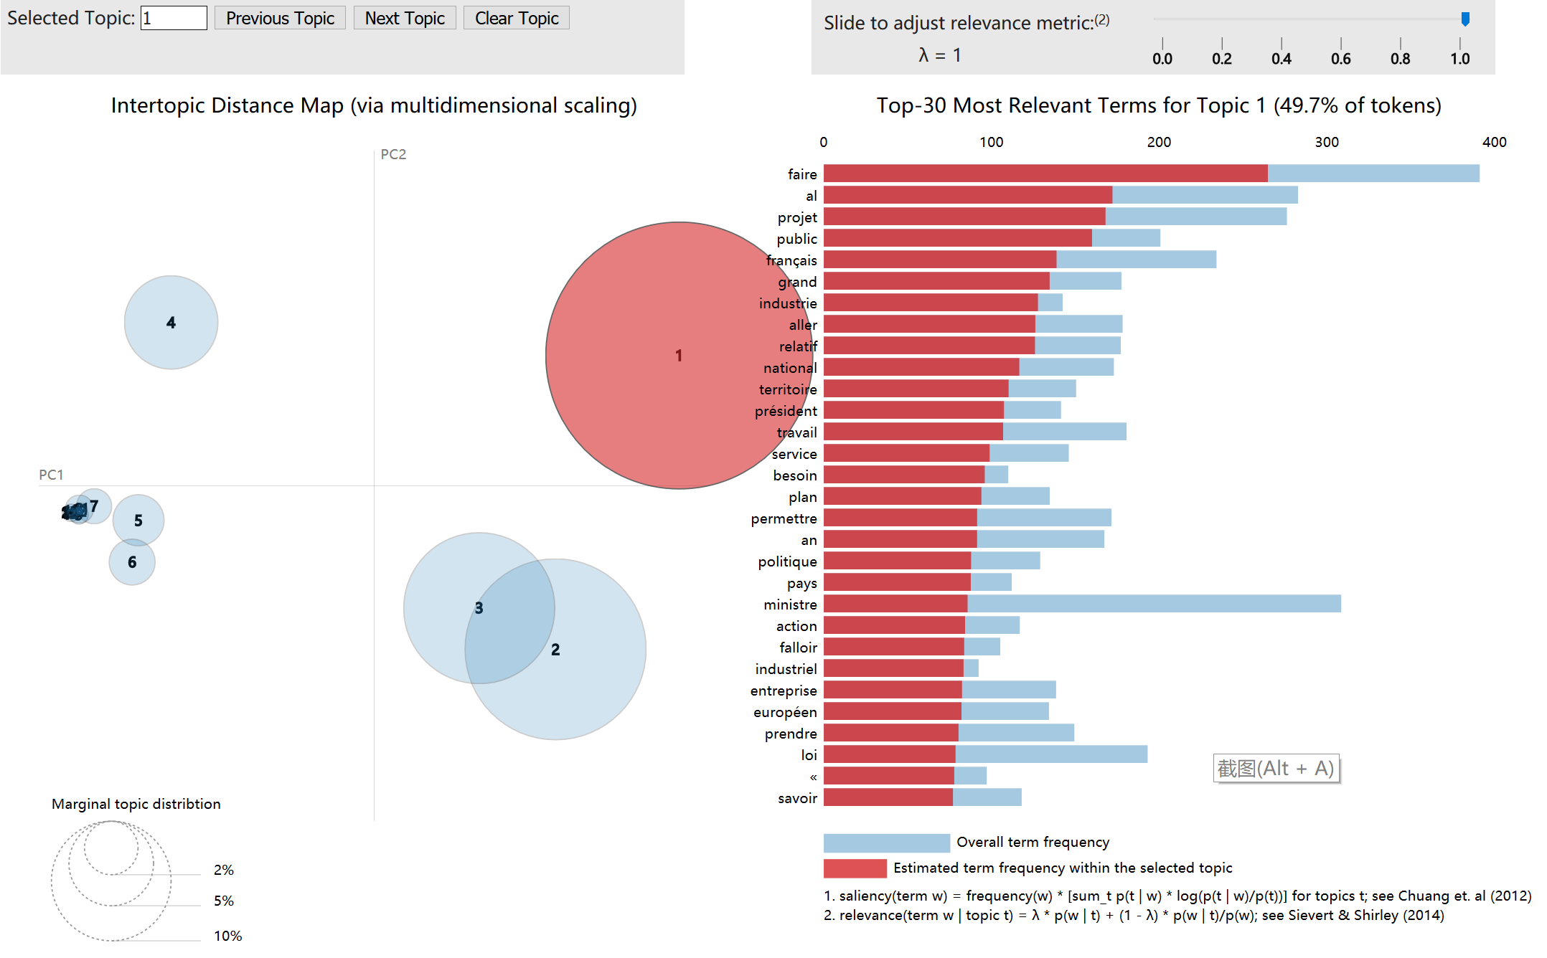
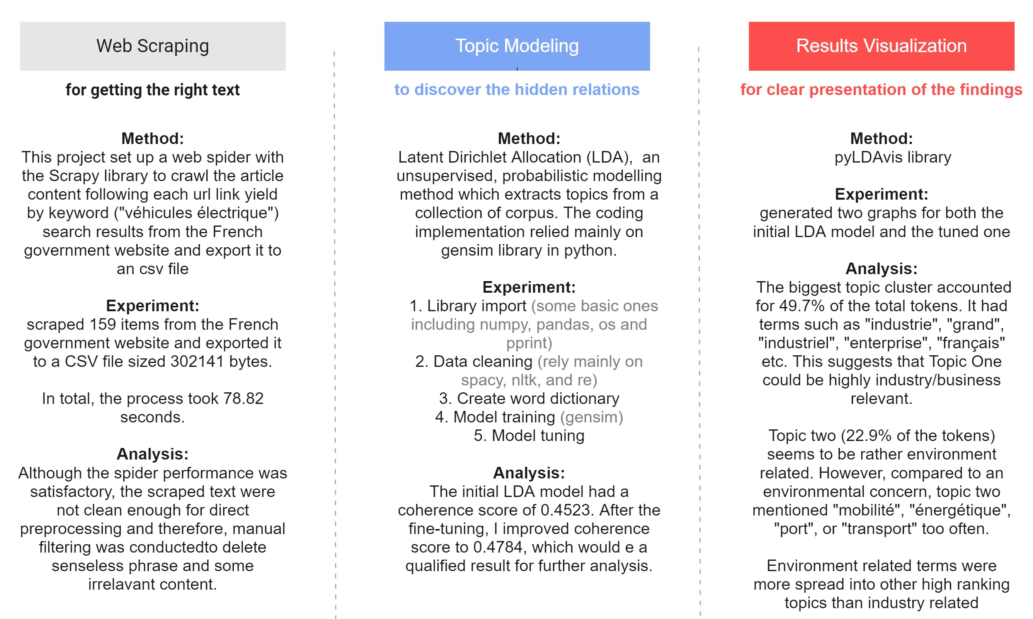

Measuring the Political Motivation behind French Government's Endorsement for Electric Vehicles
Team Project by Hu, Xiaoyan for the Course: Python Programming for Data Scientists, Hertie School
Background
In 2013, Bradley W. Lane and others identified two motivations for why governments seek to promote the electric car: risk management in response to ecological or energy concern versus industrial policy seeking an economic upgrade. He believed the French government lied in between these two positions.
Update Lane’s 2013 conclusion on French government’s political motivation;
Explore an alternative position articulation method other than the conventional human text reading approach.
Research Motivation
Project Implementation and Results
Topic visualization using pyLDAvis on the tuned results
Analysis and Conclusion
This project finds that although the political motivation of the French government behind its electric vehicle policy remains mixed judging from publications of this government, the eager for industrial transition upgrade outweighs environmental concerns.
environment issues is associated with many topics and thus is maybe a more wide-spread concern of the French government. However, on concrete working projects, policymakers probably still let national industrial transition occupy much of their mind.
Both Scrapy and LDA are easily scalable and can be adapted to future research of a similar nature with a much bigger corpus. However, it still leaves an open question on how much domain knowledge is still required to select the right text for machine analysis or the “truth” will ultimately reveal itself as long as we feed the algorithm with enough data.
Notes:
Hi, this is Adele
Thanks for listening to my project presentation for the course Python Programming for Data Scientists at Hertie School
Public policies are often out of mixed motivation. If we don't want to read hundreds of press release, meeting notes and speeches on our own, how can we know what's in the mind of policymakers?
This project aims at exploring an alternative with the case study "on Political motivation behind French government's endorsement for the electric vehicle industry". I divide my project implementation into three parts:
Crawl all relevant documents from the French government website using the scrapy library
discover the hidden relations between terms and topics by constructing a latent dirichlet allocation topic modeling with gensim library
Visualize the findings with pyLDAvis package, showing the proportion of each topic in the corpus and their relative distance
On the right hand side of the poster, you can see a screen shot of the interactive graph generated with pyLDAvis package.
This project finds that there is a high concentration of industry related terms in topic one, shown as the biggest red circle. It implies that government eagerness to plan an industrial upgrade probably outweighs ecological concerns. Environment related terms are more widely and equally associated with high ranking topics. Thus, it is maybe a more prevalant theme for the French government.
Both Scrapy and LDA are easily scalable and can be adapted to future research of a similar nature with a much bigger corpus.
I am looking forward to your feedbacks, thanks for listening

